Slide 1
Iteration 5
Dolphins 2021

Slide 2

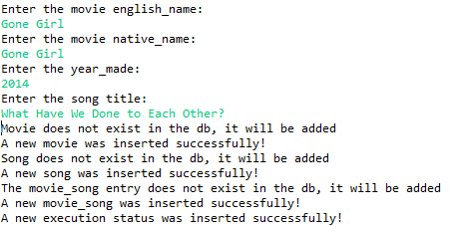
Case 1: Movie is created if movie doesn’t exist

Slide 3


Slide 4
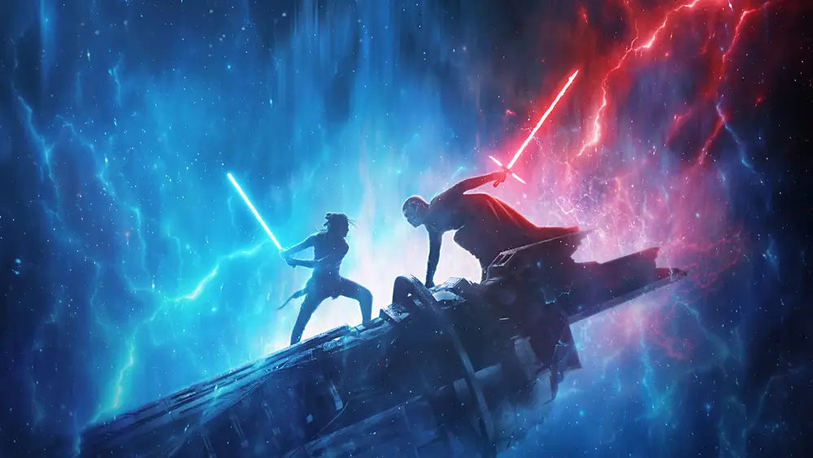
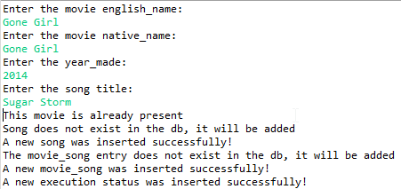
Case 2: Movie is ignored if movie already exists

Slide 5


Slide 6
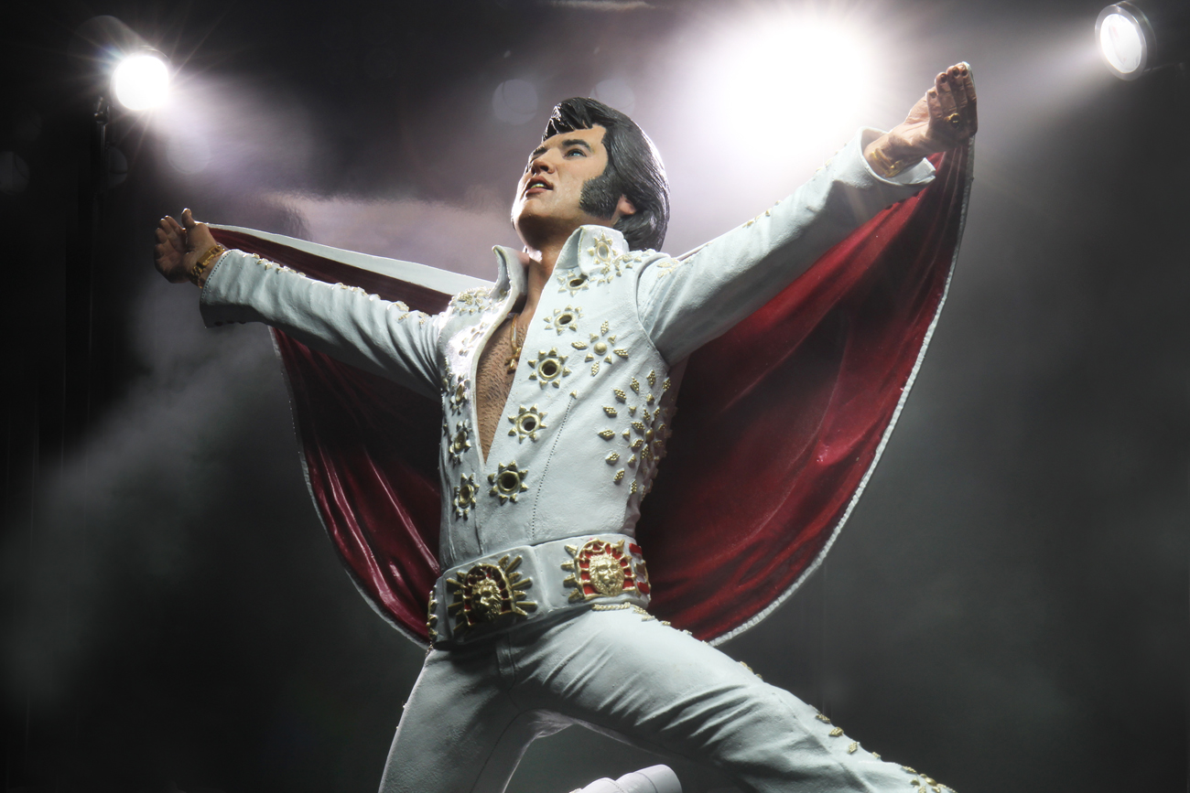
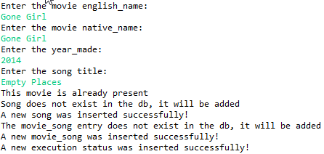
Case 3: Song is created if song doesn’t exist

Slide 7


Slide 8
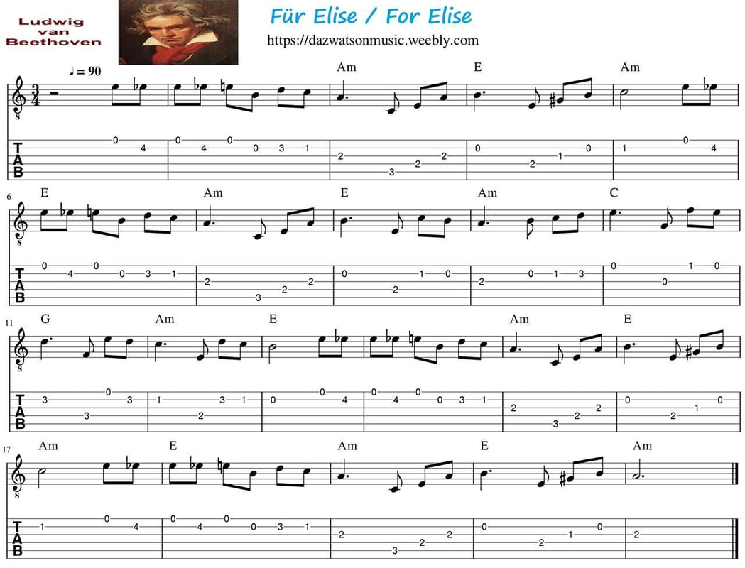
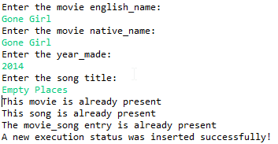
Case 4: Song is ignored if song exists

Slide 9


Slide 10
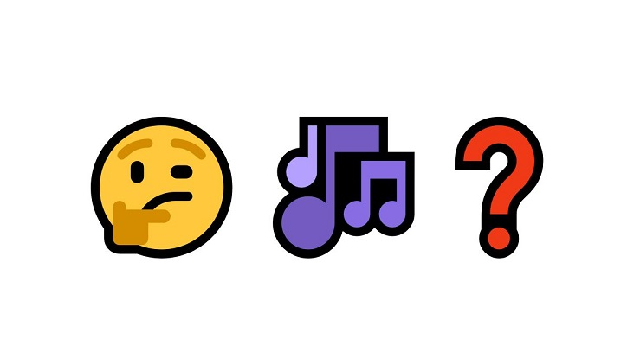
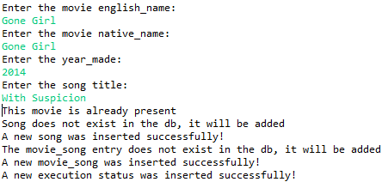
Case 5: Song Name doesn’t exist and is added

Slide 11


Slide 12

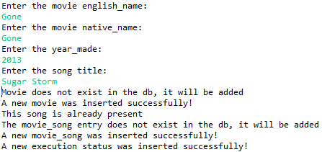
Case 6: Song name does exist and isn’t added

Slide 13


Slide 14
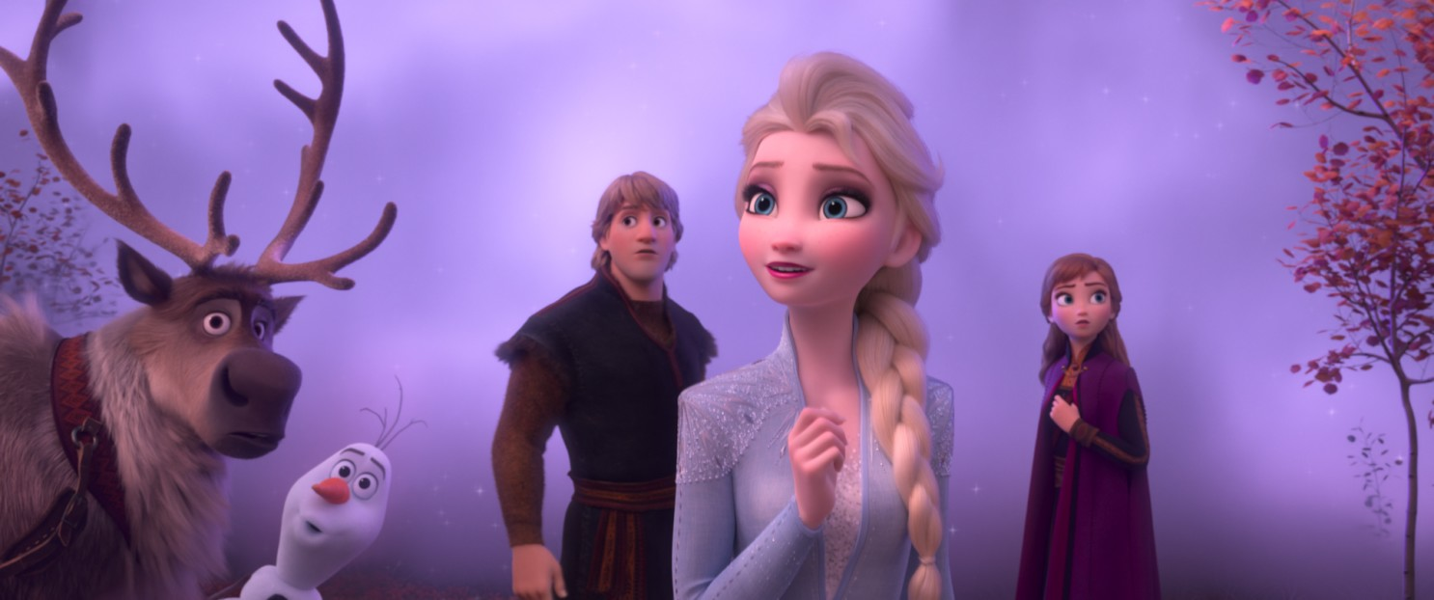
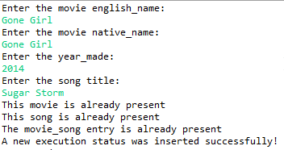
Case 7: Movie, Song, and Song Title already exist

Slide 15


